Slide 1
Fundamentals of Electric Grid Transmission Plannning
Talk 18: Communicating Results
And Wrap Up
Tracy Rolstad
Tracy.Rolstad@trinasolar.com

Slide 2
Apply the various Rules of Journalism
First rule…work with your existing documentation
Presumably, you have some sort of report to build from
The W’s + H
Who, What, When, Where, Why and How.
Think nontraditionally
Writer's block? Give Chat GTP a go…surprisingly good if you ask the proper questions
1

Slide 3
Journalism W’s plus H
Who are you? Who will read this?
State your function, department, company, etc. Write to the audience
What is the document? What do you need to say?
Planning Assessment, single project, interconnection request, GMD report, etc
When?
Date documents, version control, if compliance driven spell out periodicity
Where?
Maps, one-lines, geo-location, cities, counties, states, interconnection, country, etc
Why are you doing this?
Compliance, lack of performance, interconnection request, documentation, etc
How
Describe study techniques, tools used, cases used, etc
If there is no Why don’t do it!

Slide 4
ChatGPT: Generation Interconnection Report
Key components of a generation interconnection report may include:
System Impact Study:
This study evaluates the impact of connecting the new generation facility to the grid. It assesses the facility's effects on grid stability, voltage regulation, and overall system performance.
Interconnection Requirements:
The report will detail the technical requirements for the interconnection, including voltage levels, protection schemes, and equipment specifications.
Cost Estimates:
It may include estimates of the costs associated with upgrading grid infrastructure to accommodate the new generation facility, such as building new transmission lines or installing additional equipment.
Interconnection Agreement:
The report may also include an interconnection agreement between the generator and the grid operator, outlining the terms and conditions of the connection.
Environmental Impact Assessment:
Depending on the regulations and requirements in the area, the report may also address environmental considerations related to the generation facility's connection to the grid.
Safety Considerations:
Any safety considerations related to the interconnection, such as protection against overloads or faults, will be outlined in the report.

Slide 5
Powerflow Study writers block? Editing is easy
Here's an overview of what a power flow study typically involves (from ChatGPT):
Network Representation:
The power system network is represented using a mathematical model, often as a set of equations describing the relationship between voltage magnitudes, phase angles, and power injections at various nodes and branches.
Load Modeling:
The power consumption of loads connected to the network is modeled. This includes both active power (real power) and reactive power (imaginary power) consumption.
Generator Modeling:
The power output of generators connected to the network is modeled. This includes both synchronous generators (such as thermal power plants and hydroelectric generators) and asynchronous generators (such as wind turbines and solar PV systems).
Transmission Line Parameters:
The parameters of transmission lines (such as resistance, inductance, and capacitance) are incorporated into the model.
Constraints:
Various operational constraints, such as voltage limits, line capacity limits, and generator operating limits, are considered in the analysis.
Solution Techniques:
Numerical methods, such as the Gauss-Seidel method, Newton-Raphson method, or fast decoupled method, are used to solve the system of nonlinear equations representing the power flow equations.
Output Analysis:
The results of the power flow study provide information about the steady-state operating conditions of the power system, including voltage profiles, power flows on transmission lines, and generator operating points. This information is crucial for system planning, operation, and reliability analysis.

Slide 6
Operations versus Planning
Operations: NERC TOP standards are a driver
Daily, weekly, monthly, seasonal plans (now!)
Switching orders, operating limits, prescriptive, if this-then that
Focus on SCADA poke-points, nomograms, responsibilities, actions, etc
Study Limit Memo’s, daily’s, modifications to standing orders, etc
Planning: NERC TPL standards are a driver
Time frames typically greater than 1 year out (tomorrow)
Assessments, projects, interconnections, construction/equipment standards, etc
There is no emergency planning

Slide 7
Table of Contents from Interconnection Study
1. Study Overview
1.1. Generating Facilities
1.2. Cost Estimate Summary
2. Scope of Study
3. Description of Proposed Interconnection
3.1. Interconnection Request Identification
3.1.1. Project description and one line diagram
3.1.2. Project Upgrade Requirements
3.1.3. Notable Area or System Constraints
4. System Requirements for Shared Network Upgrades
4.1. Transmission System Requirements
4.2. Protection Requirements
4.3. Communications Requirements
4.4. Metering Requirements
5. Technical Analysis and Results
5.1. Simulation and Modeling Methodology
5.2. Study Area Representation
5.2.1. Load Profile (Usage) of Existing Transmission Line
5.3. Steady State System Analysis
5.3.1. Steady State Contingency Analysis for ERIS
5.3.1.1 ERIS Sink Discussion
5.3.2. Steady State Contingency Analysis for NRIS
5.3.2.1 NRIS Sink Discussion
5.4. Stability Contingency Analysis
5.4.1. Transient Stability Model
5.4.2. Select Stability Response Plots-ERIS
5.4.3. Select Stability Response Plots-NRIS
5.4.4. Generator Response Plots-ERIS
5.4.5. Generator Response Plots-NRIS
5.4.6. Model Verification and Validation
5.5. Short Circuit Analysis
5.5.1. Short Circuit Analysis Results
5.6. Weighted Short Circuit Ratio (WSCR)
5.7. Harmonic Analysis
6. Participation by Affected Systems
6.1. Identified Issues Impacting Neighboring Systems
7. Contingent (Dependent) Facilities
8. Construction Schedule
9. Project Cost Estimate
9.1. Cluster Cost Estimate
10. Alternative Analysis
11.1. Interconnection Request Alternatives
11. Contingent Facilities Analysis
12.1. Power Transfer Distribution Factor Screen
12.2. Available Transfer Capability Screen
12.3. Available Fault Current Screen
12. Steady State Contingency Analysis
13. Appendices
Avista example
AvistaT1ClusterStudyPhaseTwo2022-V0.pdf (oati.com)

Slide 8
Planning Assessments and attachment “K”
TPL-001
Annual Planning Assessment
Look at other folk's work
Imitation is the sincerest form of flattery
Attachment “K” to what?
FERC Order 1000 (Transmission Planning and Cost Allocation)
Attachment K is “local planning”
As compared to regional planning
It is possible to combine the TPL-001 and attachment “K” reports
TPL-001 tends to be more technical and thus separate from attachment “K”

Slide 9
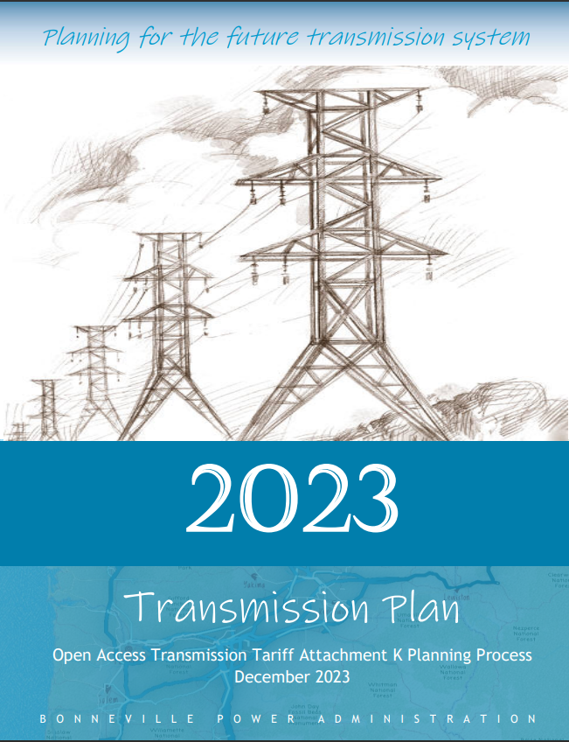
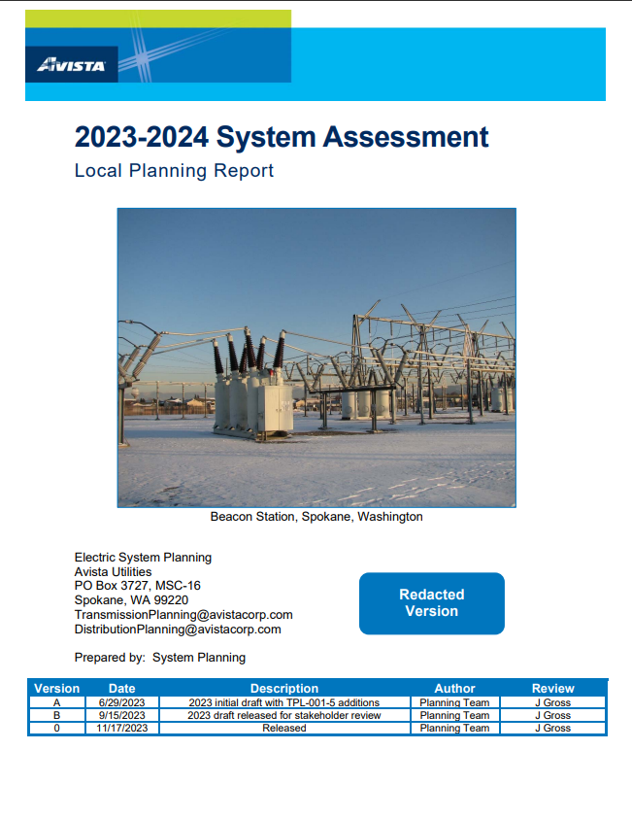
Examples (W’s focus still)
Microsoft Word - 2023 BPA Transmission Plan
Microsoft Word - 2023-2024 Avista System Assessment(Redacted)-V0.docx (oati.com)

Slide 10
How…explain the technical approach
Example Post-transient Governor Power Flow Technique
The methodology applies to all outages, whether AC or DC, that require generation tripping or load shedding to maintain stability.
Assumption considers the period after the power and voltage transient oscillations have damped out, but before system operators have had time to readjust intertie schedules (~3 minutes).
Additional influencing factors are as follows:
Transient stability analysis of the selected disturbance has found the system to be stable. There is no reason to analyze post-transient conditions where transient instability has occurred.
Sufficient time after the disturbance has elapsed such that all elements of the system experience the same uniform frequency deviation (one to three minutes).
Distribution substation voltage regulators or LTCs have sufficient regulating range and time delay settings such that distribution substation voltage is restored to the pre-disturbance voltage in one half to three minutes.
Perform studies with voltage control switching enabled (this is ~3 minutes)
Perform studies with voltage control switching disable (immediate results)
All turbine-generator governors in the system that are not blocked have the same droop setting (5%). All units initially loaded less than Pmax capability will increase or decrease load due to governor action. However, units that are blocked with the baseload flag in the basecase will not increase or decrease load due to governor action.
There is insufficient data on boiler response time and individual unit participation factors at this time to assume that automatic Generation Control (AGC) will significantly change generation within 1-1/2 to 3 minutes.

Slide 11
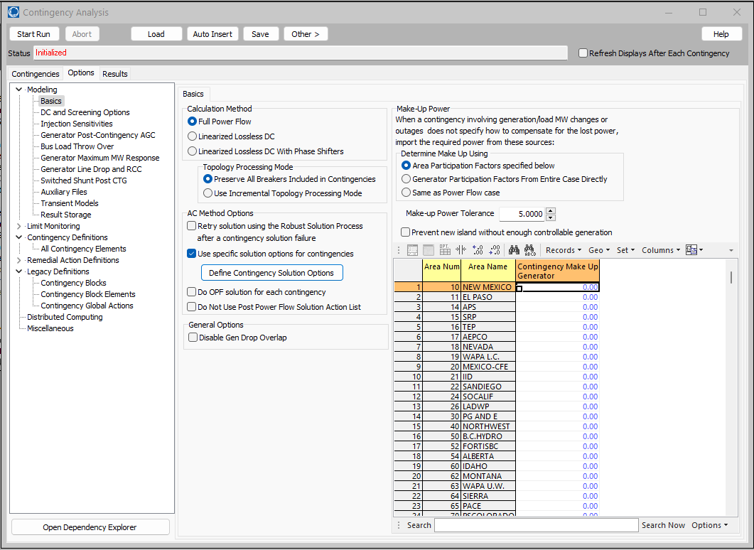
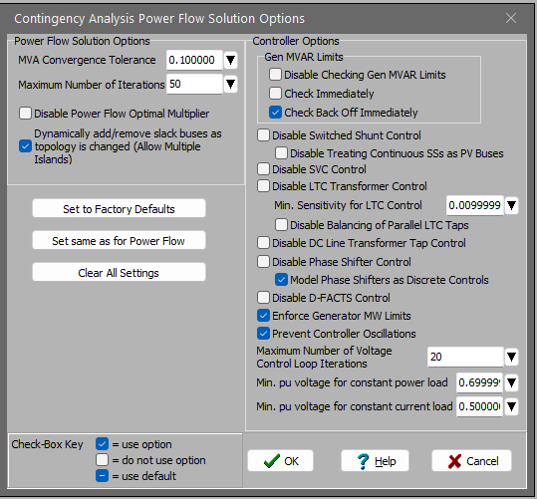
How…Graphically in PWS
This is at 3 minutes

Slide 12
Focus on the audience (Who)
Answer the question completely
Don’t play battleship when you perform interconnection studies
Tell the developer the full span of what fits
PV curve, ATC tool…if they ask for 100 MW and 55 MW works…tell them!
Conversely, if they ask for 50 MW and 100 MW is the limit, tell them!
Do you really want people to re-queue? Or hang around in the queue?
Your LGIP allows this…basically because it doesn’t disallow this
FERC Order 2023 points to this
Interconnecting parties want to pay you (the utility) to use something you aren’t using. Embrace this! Make your documentation customer focused.

Slide 13
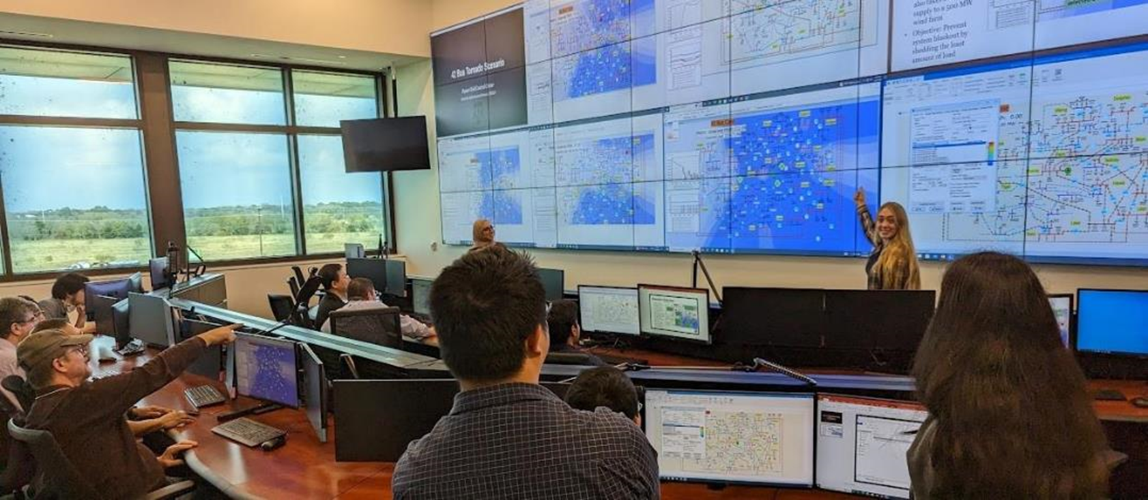
Questions?
12

